Slide 1
Direct Air Capture Using Moisture Swing Chemistry
By: Ryan Stratton
Notes:
Zoom Meeting ID: 864 3136 6439
Passcode: y1V344

Slide 2
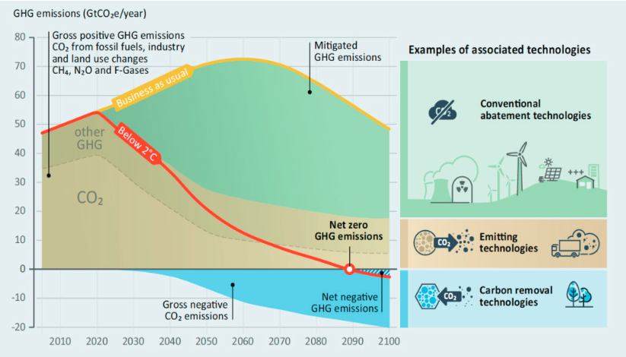
Overall objective
Problem, carbon dioxide concentrations are rising
Goal of this projects is to create a passive system to collect carbon dioxide form the atmosphere for long term storage under ground
The system being created is similar to a tree that scrubs the air
Notes:
https://www.climate.gov/news-features/understanding-climate/climate-change-atmospheric-carbon-dioxide#:~:text=The%20global%20average%20atmospheric%20carbon,plus%20or%20minus%200.1%20ppm.

Slide 3
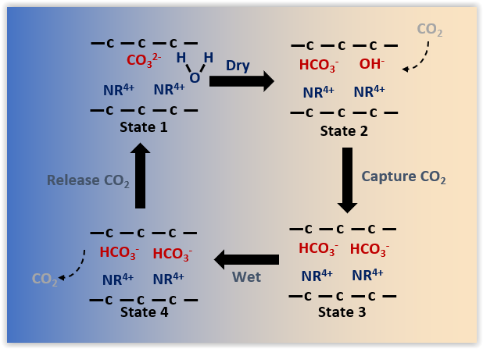
Moister Swing Phenomenon
Notes:
There are solid polymeric materials that have a charged spices in there back bone.
This generic diagram the cation is depicted as a sodium ion
When carbonate becomes dry in solid materials is hydrolyzes into bicarbonate and hydroxide
Hydroxide reacts with carbon dioxide
When the bicarbonate become wet is dehydrolyzes going back to carbonate
This research is focusing on this phenomenon

Slide 4
Governing Equation
$$f\left(T,H2O\right)=\frac{{\left[{HCO}_{3}^{−}∙nH2O\right]}^{2}}{\left[{CO}_{3}^{2−}∙mH2O\right]\left[{CO}_{2}\right]\left\lceil H_{2}O\right\rceil }$$
$$J_{i}=−D_{i}∇n_{i}−\frac{Z_{i}F}{RT}D_{i}n_{i}∇φ$$
Electrical potentials ($∇φ)$
Flux (J_{i})
Electrical field ($φ$)
Concentration of species ($n_{i}$)
Diffusion coefficients ($D_{i}$) Species Charge ($Z_{i}$)
Faraday’s constant (F)
Ideal gas constant (R)
Temperature (T)
Moisture-Swing: (wet) CO₃²⁻ + H₂O = HCO₃⁻ + OH⁻ (dry)
CO₂ Reaction: CO₂ + OH⁻ = HCO₃⁻

Slide 5
Programs used to predict fiber performance

Slide 6
Solidworks part
Low Carbon Brine
Solidworks image of a hollow fiber module as well as a close-up view of a single fiber
Similar to a shower head of fibers suspended.
Air Velocity 1 m/s
Brine in
Air Velocity
Brine out
High Carbon Brine

Slide 7
Next program is Gmsh

Slide 8
Gmsh – Wire frame for single fiber
Close up view of single fiber from Gmsh
Import the file into Gmsh
Break important parts of the structure into little volumes
The governing equation, flux, is solved on the vertices of the triangle

Slide 9
Next program is Gmsh

Slide 10
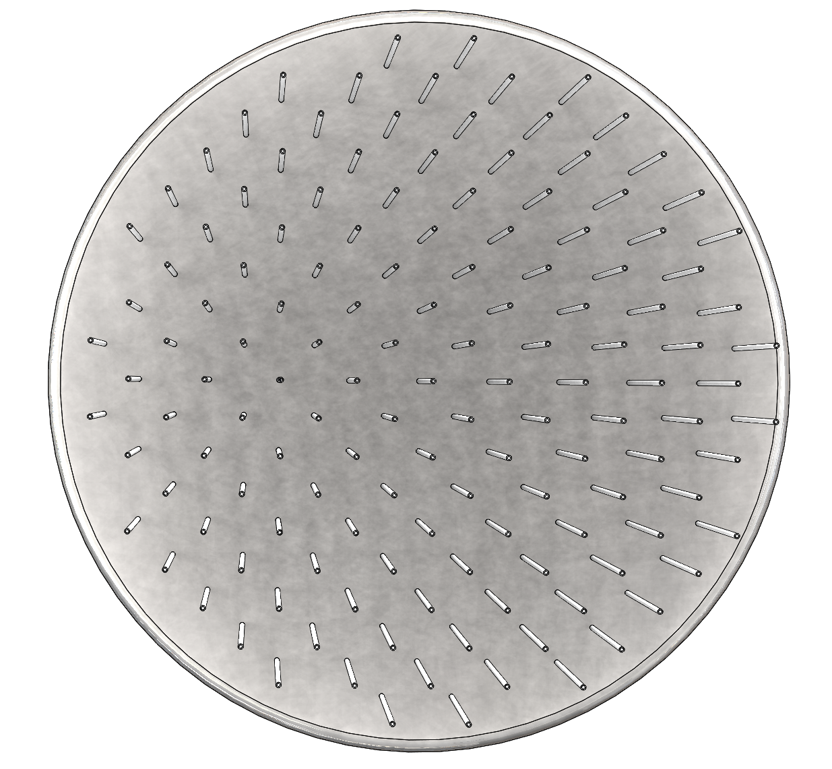
Using Fenics Project
The Gmsh file get exported out of Gmsh and into Fenics
To be able to create that finite element solver I use Fenics project which is coded in Python
The reason for this is that a single cylinder is not hard to solve for but when the geometry gets complex like the image to the right each fiber is dependent on one another

Slide 11
Air Side Mass Transfer Resistance
After completing the previous renderings, I analyzed the air side boundary condition using a Sherwood optimization
This was developed from using a heat transfer analogy, converting from Prantl’s and Nusselt’s numbers to Schmitt’s and Sherwood’s numbers

Slide 12
Wrap up
I have been working on creating files in Solidworks to be able to analyze systems in Fenics
Using Gmsh I can define boundary conditions for Fenics when solving partial differential equations
As well as working the air side mass transfer of the system

Slide 13
Acknowledgements
Organizations funding the project
U.S. Department of Energy
Advanced Research Projects Agency-Energy (ARPA-E)
NASA Space Grant Consortium
Advisor
Dr. Jenifer Wade
Mechanical Engineering, Northern Arizona University

